Slide 1
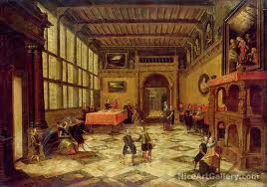
The Renaissance
1485-1660

Slide 2
The Renaissance = “Rebirth”
Marked by a renewal of curiosity and creativity, and a change in the way people thought about themselves, God, and the world
No longer content with religious beliefs of the Middle Ages
More interested in history, art, science, and especially the classic texts of ancient Greece and Rome
The Church lost its position as the supreme moral and political power in Europe by the end of the 16th century

Slide 3
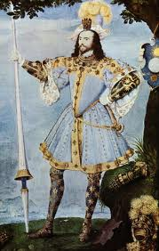
Fashion
Rich fabrics: velvet, fur, taffeta
Silk stockings, platform shoes
Makeup, perfumed gloves, curled hair
Earrings, pearls, bracelets
Designs sewn all over their clothes

Slide 4
Symbolism
Green = Love
Pansy = Sadness
Snake = Flattery
White and Black together = Chastity
Whole treatises were devoted to color and to defining “emblems” such as rainbows, clouds, worms, and flies

Slide 5
Quick Write
How will historians of dress read the clothes we wear today?
What messages do our clothes send out to the world?
What will they tell the future?

Slide 6
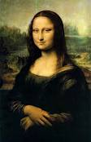
A Flourish of Genius
Began in Italy
Leonardo da Vinci
Michelangelo
Christopher Columbus
Galileo

Slide 7
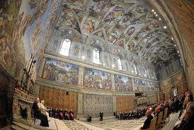
Michelangelo

Slide 8
Humanism
Intellectual movement
Sought to answer questions such as “What is a human being?” “What is a good life?” “How do I lead a good life?”
Believed the answers could be found in both the Bible and in classic Greek and Latin texts
BIG IDEA: the aim of life is to attain virtue, not success, money or fame

Slide 9
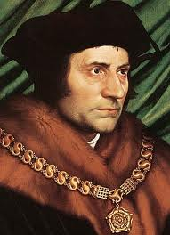
Thomas More
Created the idea of a “Utopia”

Slide 10
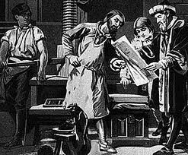
New Technology
Moveable printing press invented by Johannes Gutenberg in 1440

Slide 11
Breaking with the Church
Feelings of patriotism and national identity led the people to resent the financial burdens imposed on them by the Vatican
Martin Luther (Germany) nails 95 theses to church door
New Christianity based on personal understanding of the Bible, not what the pope said

Slide 12
King vs. Pope
King Henry VIII – six wives; Catherine of Aragon, Anne Boleyn, Jane Seymour, Anne of Cleves, Catherine Howard, and Catharine Parr
Divorced, beheaded, died,
Divorced, beheaded, survived
Pope Clement VII would not grant him a divorce from his first wife
Henry declared himself the head of the English Church

Slide 13
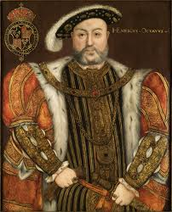
King Henry VIII
Created the Royal Navy
Wrote poetry
Played many musical instruments
Champion athlete and hunter
Supported new humanistic learning
Three children: Mary, Edward, and Elizabeth

Slide 14
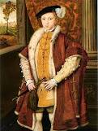
Edward VI
Crowned at age 9
Ruled from 1547-1553
Died of tuberculosis

Slide 15
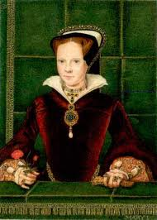
Bloody Mary
Reigned from 1553-1558
Restored the pope’s power in England
Ruthlessly hunted down Protestants
Burned about 300 people at the stake
Married King Philip II of Spain
Died of a fever

Slide 16
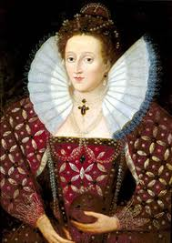
Elizabeth I: The Virgin Queen
Reigned from 1558-1603
One of the most brilliant and successful monarchs in history
Reestablished the Church of England
Beloved symbol of peace, security, and prosperity

Slide 17
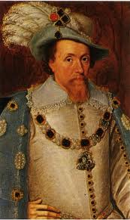
King James I
King James VI of Scotland, second cousin of Elizabeth
Reigned from 1603-1625
Patronized Shakespeare
Sponsored a new translation of the Bible: KJV in 1611
Most printed book in the history of man
More than a million copies sold every year
http://channel.nationalgeographic.com/jesus-rise-to-power/videos/how-the-bible-began/

